Slide 1
CS217 Object Oriented Programming
Polymorphism and Virtual functions

Slide 2
Overriding a functions in the subclass
When a subclass declares a function of the name previously known in its superclass, the original method is overridden. This means that the subclass hides the previous meaning of the function identifier and any invocation encoded within the subclass will refer to the newer method.

Slide 3
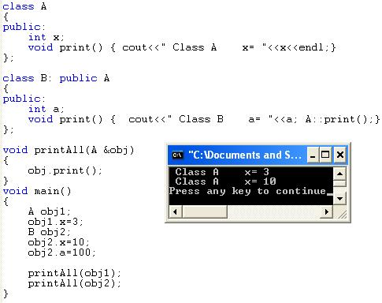
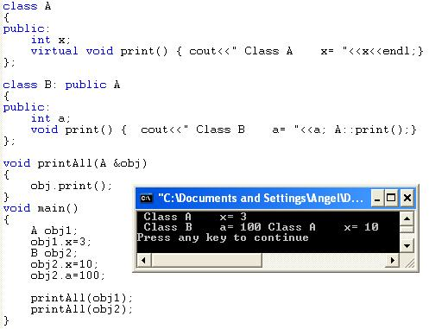

Slide 4
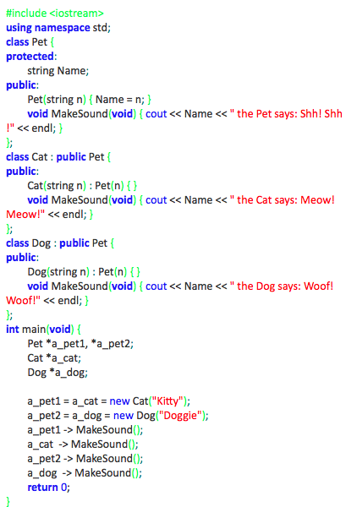
Overriding a function in the subclass

Slide 5
Overriding a method in the subclass
I want to ask you now for your full attention as we are going to introduce one of the most important objective notions:
Polymorphism.
This is a method to redefine the behavior of a superclass without touching its implementation.

Slide 6
Overriding a method in the subclass
The word “polymorphism” means that the one and same class may show many (“poly”) forms (“morphs”) not defined by the class itself, but by its subclasses.
Another definition says that polymorphism is the ability to realize class behaviour in multiple ways.
Both definitions are ambiguous and could not actually be used to explain the true nature of the phenomenon. I believe that an example will work better.

Slide 7
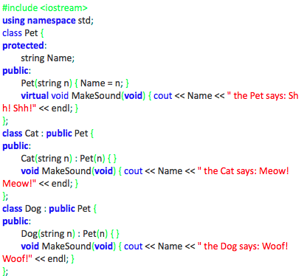
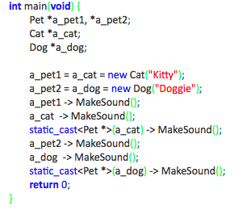
Take a look at the code below. It’s almost the same as the previous one. The main function may look different but the class definitions are nearly identical. There’s only one difference – one keyword has been added to the code.
Can you find it?

Slide 8
Overriding a method in the subclass
Yes, you’re right – it’s the word “virtual”, placed in front of the MakeSound member function, inside the Pet class body.
This word means that the method won’t be overridden within any of the possible subclasses. It also means that the method will be redefined(replaced) at the level of the original class.
To make a long story short – the example program will output a somewhat surprising piece of text. This is how it goes:
Kitty the Cat says: Meow! Meow!
Kitty the Cat says: Meow! Meow!
Kitty the Cat says: Meow! Meow!
Doggie the Dog says: Woof! Woof!
Doggie the Dog says: Woof! Woof!
Doggie the Dog says: Woof! Woof!

Slide 9
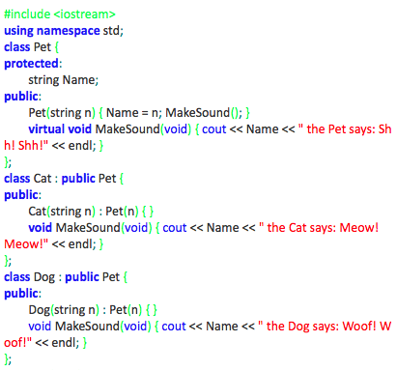
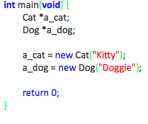
6.3.4 Overriding a method in the subclass (4)
The next example shows that the binding between the origin of the virtual function (inside the superclass) and its replacement (defined within the subclass) is created dynamically, during the execution of the program.
Take a look at the example →

Slide 10
6.3.4 Overriding a method in the subclass (4)
We invoke the MakeSound method as part of the Pet constructor. We already know that the method is polymorphically replaced by the new implementations presented by the Cat and Dog subclasses. We don’t know yet when the replacement occurs.
The program will output the following lines:
Kitty the Pet says: Shh! Shh!
Doggie the Pet says: Shh! Shh!
This means that the binding between the original functions and their polymorphic implementations is established when the subclass object is created, not sooner.

Slide 11
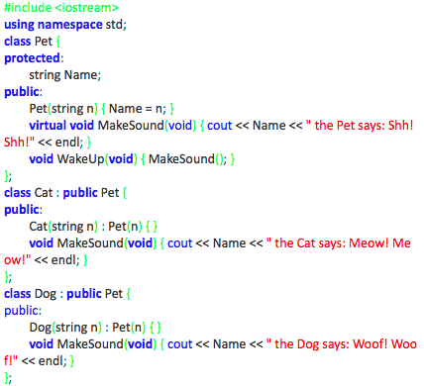
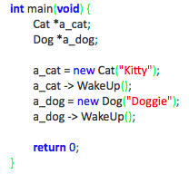
6.3.5 Overriding a method in the subclass (5)
Overriding a method in the subclass – continued
The experiment we’re going to perform using our software guinea pig refers to the fact that the virtual method may be invoked not only from outside the class but also from within.
Check out this example, please →

Slide 12
Classes and Virtual Destructors
Classes with pointer member variables should have the destructor
Destructor can be designed to deallocate storage for dynamic objects
If a derived class object is passed to a formal parameter of the base class type, destructor of the base class executes
Regardless of whether object is passed by reference or by value
Solution: use a virtual destructor (base class)

Slide 13
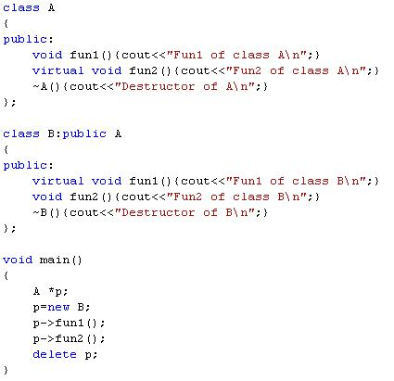
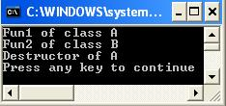

Slide 14
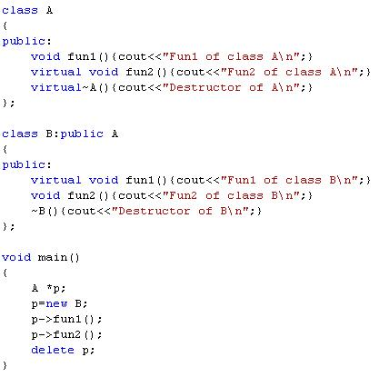
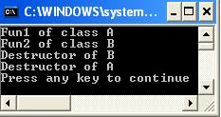

Slide 15
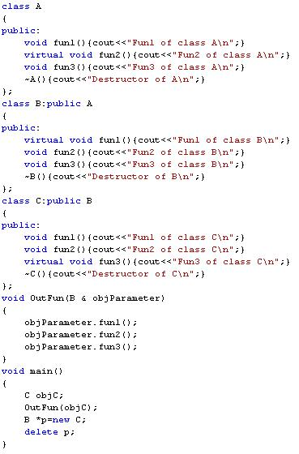
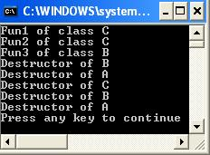
Virtual functions for class A:
fun2
Virtual functions for class B:
fun1 and fun2
Virtual functions for class C:
fun1 and fun2 and fun3

Slide 16
Classes and Virtual Destructors (continued)
The virtual destructor of a base class automatically makes the destructor of a derived class virtual
After executing the destructor of the derived class, the destructor of the base class executes
If a base class contains virtual functions, make the destructor of the base class virtual

Slide 17
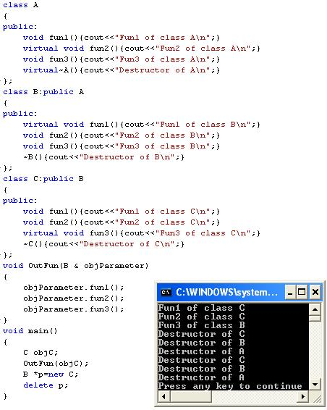

Slide 18
Abstract Classes and Pure Virtual Functions
Through inheritance, we can derive new classes without designing them from scratch
Derived classes inherit existing members of base class, can add their own members, and also redefine or override public and protected member functions
Base class can contain functions that you would want each derived class to implement
Base class may contain functions that may not have meaningful definitions in the base class

Slide 19
Abstract Classes and Pure Virtual Functions (continued)
To make them pure virtual functions:

Slide 20
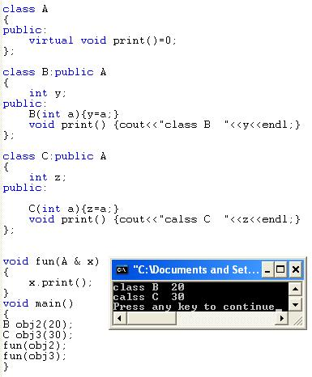
A
B
C
Y
Z

Slide 21
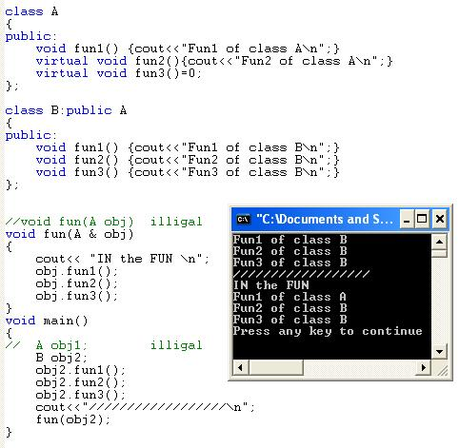
Virtual functions
Class A is Abstract class
Class B is non abstract class

Slide 22
Abstract Classes and Pure Virtual Functions (continued)
Abstract class: contains one or more pure virtual functions
You cannot create objects of an abstract class

Slide 23
Abstract Classes and Pure Virtual Functions (continued)
If we derive rectangle from shape, and want to make it a nonabstract class:
We must provide the definitions of the pure virtual functions of its base class
Note that an abstract class can contain instance variables, constructors, and functions that are not pure virtual
The class must provide the definitions of constructor/functions that are not pure virtual

Slide 24
